Slide 1
DIGITAL MARKERTING
Project

Slide 2
TEAM DETAILS
SANDURU KUSUMA (TEAM LEADER)
UJJURU INDHU(TEAM MEMBER)
VADAVALASA PUSPHA LATHA(TEAM MEMBER)
VANA LATHA (TEAM MEMBER)
VAYIBOYINA MOUNIKA(TEAM MEMBER)

Slide 3
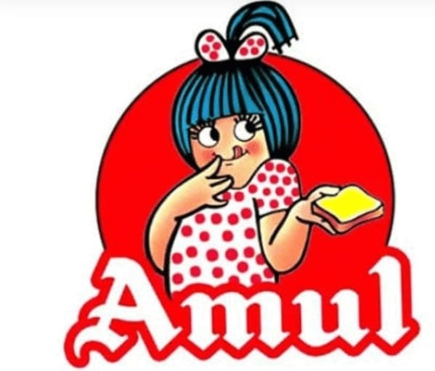
RESEARCH BRAND:AMUL

Slide 4

AMUL
Amul is one of the most popular and successful brands in India. With its wide range of dairy products, Amul has now become a household name in the minds of Indian families.
Amul was established in 1946 not merely as a brand but as a movement too. A movement that gave the farmers of Gujarat the courage to Dream, Hope, and Live. It was founded with the purpose to stop the exploitation done by the middlemen “Pestonjee Edulji” who marketed Polson butter.

Slide 5
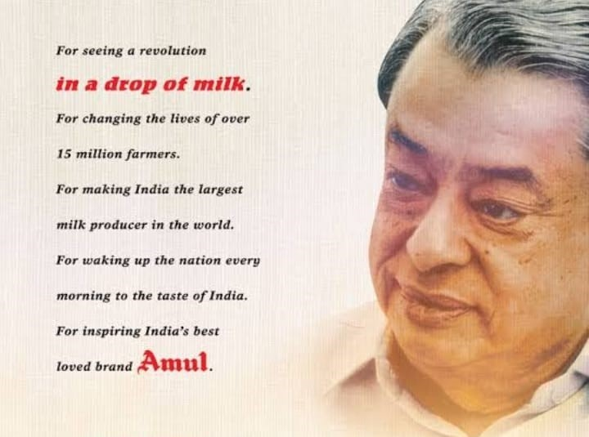
INTRODUCTION
Dr. Verghese Kurein, who is known as the “Milkman of India”, was responsible for turning India from a milk-deficient country to the largest producer of milk in the world today in which Amul has played a key role.

Slide 6

Mission/values:- Amul's vision is to provide more and more satisfaction to the farmers, employees and distributers” Mission . GCMMF endeavour to satisfy the taste and nutritional requirements of the customer of the world through excellence in the marketing by the committed team.

Slide 7
Brand Tone and identity: Amul's brand identity is centred around the iconic “Amul girl,” a young girl in a polka-dot dress who has become synonymous with the brand

Slide 8
Smart goals and kpi’s: Goals:Amul to provide remunerative returns to the farmers and also serve the interest of consumers by providing quality products which are good value for money. Kpi(key performance indicators): 1.New Product Releases 2.CustomerSatisfaction Score (CSAT) 3.Research & Development as a Percentage of SalesTeam 4.Team Velocity 5.New product sales

Slide 9
AUDIENCE RESPONSE

Slide 10
Swot analysis: 1.competitor analysis: cadbury
STRENGTH | WEAKNESSES | OPPORTUNITIS | THREATS
STRONG BRAND GLOBAL PRESENCE WEALTHY PARENT COMPANY | LIMITED PRODUCT RANGE PRODUCT RECALLS LACK OF US RIGHTS | EMERGING MARKETS PRODUCT RANGE EXPANSION | SUGAR TAX HEALTH CONSCIOUSNESS

Slide 11
2.Competitor analysis : Baskin Robbins
STRENGTH | WEAKNESSES | OPPORTUNITIES | THREATS
VARITIES OF FLAVOURS QUALITY PRODUCTS GREAT CUSTOMER SERVICE | EXPENSIVE PRICE LESS VEGAN OPTIONS AND THEIR AVAILABILTY | INCREASING MORE INTERNATIONALLY BETTER ADVERTISING | NEGATIVITY ASSOCIATED WITH SUGAR AND DAIRY AVAILABILITY OF ALTERNATIVE ICE CREAM

Slide 12
3.Comptitor analysis:kwality walls
STRENGTH | WEAKNESSES | OPPORTUNITIES | THREATS
BACKING OF HUL WIDE RANGE OF PRODUCTS POSITIONING PRICING | FOCOUS OF METROS ONLY LEGAL WARS IMAGE OF MULTINATIONAL | DEMAND FOR HEALTHY ICE CREAMS CHANGE OF CONSUMER PREFERENCES | COMPETITION CONTEST

Slide 13
SEO&KEYWORD REASEARCH SEO AUDIT: https://en.wikipedia.org/wiki/Amul https://fr.wikipedia.org/wiki/Amul http://www.amuldairy.com/index.php/13-csr-initiatives?limitstart=0 https://www.refresh-stage-ijcvyfy-n3wrec734r3j2.us-4.platformsh.site/milking-planet https://www.refresh-stage-ijcvyfy-n3wrec734r3j2.us-4.platformsh.site/milking-planet

Slide 14
KEY WORD RESEARCH: 1.amulets 2.amulet 3.samulesing 4.amule 5.jamul ca sino

Slide 15
On page optimization https://www.seoptimer.com/amul.com#hasTwitterTags38665957

Slide 16
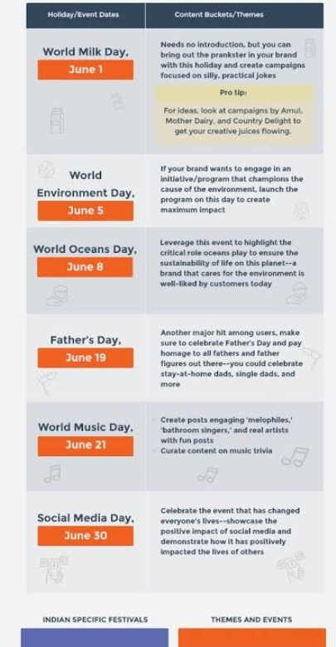
Content calnder

Slide 17
INSTAGRAM STORY Story link: https://instagram.com/stories/cream._.stone/3212476772818227371?utm_source=ig_story_item_share&igshid=NjZiM2M3MzIxNA== profile link: https://instagram.com/cream._.stone?igshid=OGQ5ZDc2ODk2ZA==

Slide 18

DESIGNS/VIDEO EDITING

